Slide 1
Introduction of AUTOSAR
Date : 01/04/2024

Slide 2
AUTOSAR Fundamentals:
AUTOSAR stand for Automotive Open System Architecture
The AUTOSAR development partnership was founded in 2003 with the goal of establishing an open standard for electrical/Electronic architecture in the automotive industry.
“Cooperate on standards, compete on implementation”
Releases : Release Ver2.0 ~ Ver4.X (4.4 - 2018)
AUTOSAR Classic Platform &
AUTOSAR Adaptive Platform

Slide 3
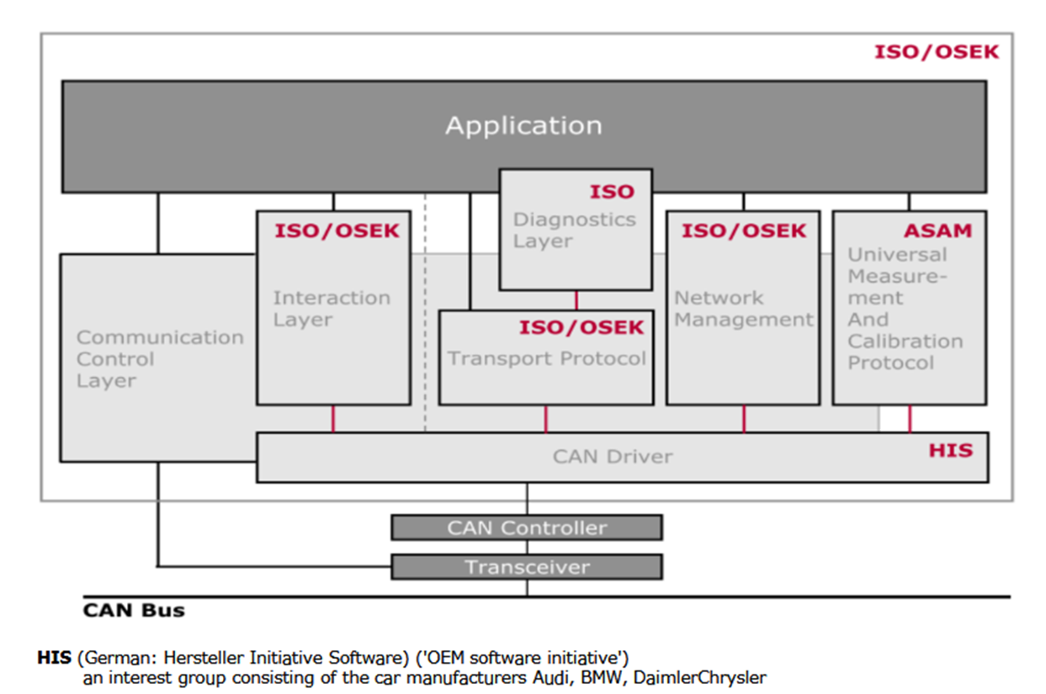
Before and After AUTOSAR
Before AUTOSAR software and hardware are depended so if any change happens in the hardware whole application/software need to change.
And these changes will require a lot of invested extra time to make the project functional again.
So, in AUTOSAR it is layer architecture so that only impacted layer will be the one that interacts directly with the microcontroller.

Slide 4
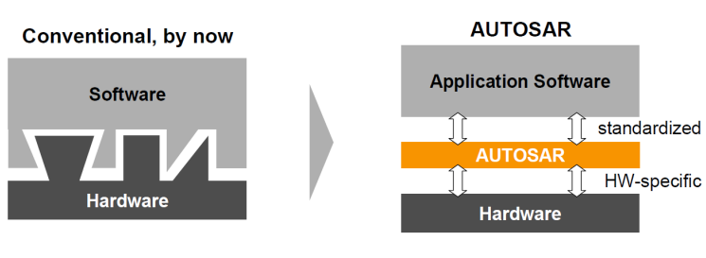
Using AUTOSAR, the software components are entirely independent of the hardware.
In other words, the application doesn’t need to know where the dependencies and inputs come from.
so, it can be reused in any other project multiple times, saving a lot of time and money. Without this standard, the software components must be re-developed by the underlying hardware every time.

Slide 5
Objective: AUTOSAR provides specifications of basic software modules, defines application interfaces and builds a common development methodology based on standardized exchange format. Basic software modules made available by the AUTOSAR layered software architecture can be used in vehicles of different manufacturers and electronic components of different suppliers, thereby reducing expenditures for research and development.
Modularity: customizing software regarding the specific requirements of each ECU and its tasks.
Scalability: avoiding software redundancy by adapting common modules to different vehicles platforms.
Transferability: optimizing the use of available resources within the electronic architecture of the vehicle.

Slide 6
Reusability: improving product quality and reliability.
Standardization: standardizing interfaces between different software layers across manufacturers and suppliers.
If a new software component needs to be added, using the standard, the focus will only be on implementing the inside algorithm, without adapting to the OEM environment.

Slide 7
AUTOSAR Architecture
AUTOSAR is an open system architecture for automotive software development and provides standards for developing common automotive software applications.
It is a growing and evolving standard that defines a layered architecture for the software.
The classic AUTOSAR platform runs on a microcontroller and is divided into 3 main layers.
Basic Software Architecture- It is common to any AUTOSAR ECU.
AUTOSAR Runtime Environment
Application Layer

Slide 8
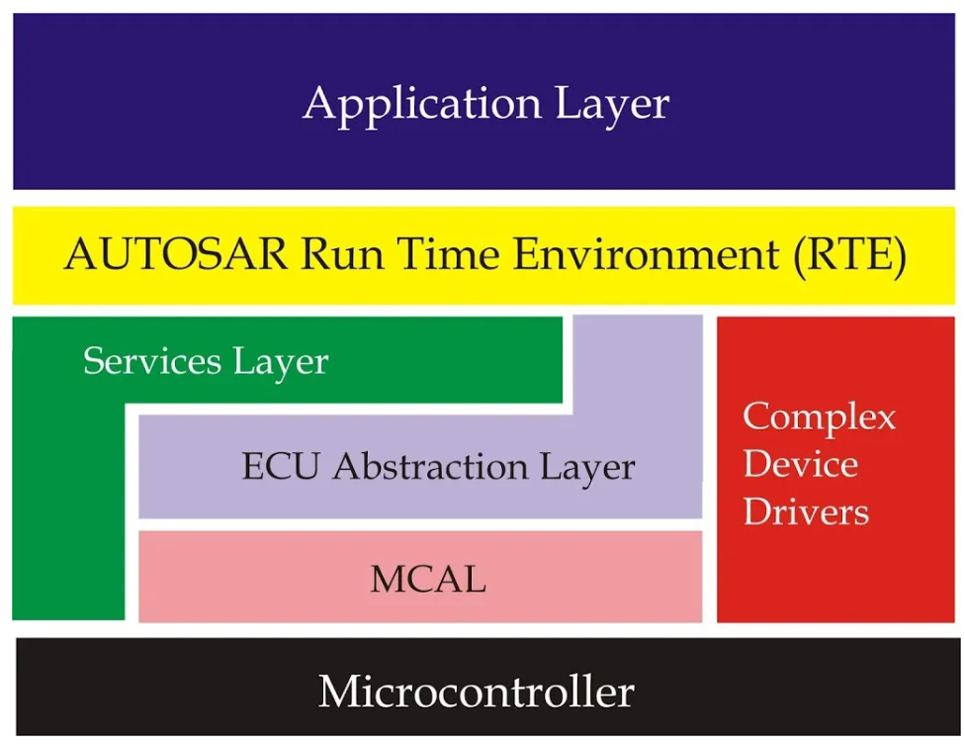
BSW
(BasicSoftware Layer)

Slide 9
Application Layer
The application layer is the first layer of the AUTOSAR software architecture and supports custom functionalities implementation. This layer consists of the specific software components and many applications which perform specific tasks as per instructions.
The AUTOSAR standard specifies the application layer implementation using a “component” concept.
The AUTOSAR application layer consists of three components which are:
Application software components
Ports of software components
Port interfaces.

Slide 10
Application Software Component
Introduction
The application layer consists of the specific software components and many applications which perform specific tasks as per instructions.
The AUTOSAR standard specifies the application layer implementation using a “component” concept.
Software Component is not only logic block, it also contains ports, port interfaces, runnable entities, internal behavior, configuration parameters.

Slide 11
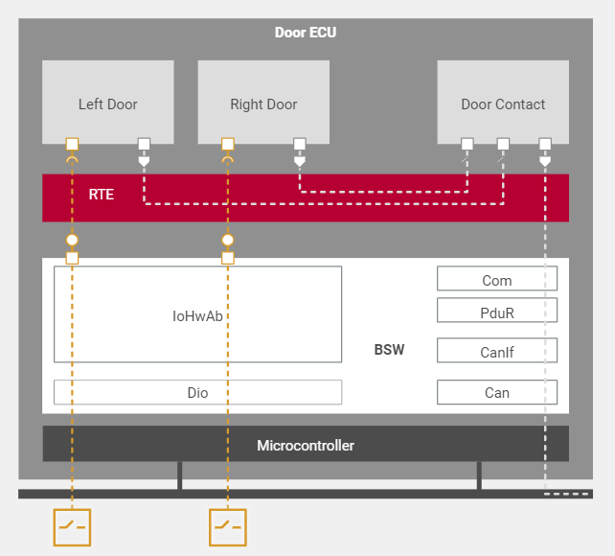
At the beginning , a system is only described by its functionality. Sub-functionalities are distributed to components. These components transfer information to other components utilizing defined interfaces.
Eg: Door control
Components:
Right Door
Left Door
Door Contact

Slide 12
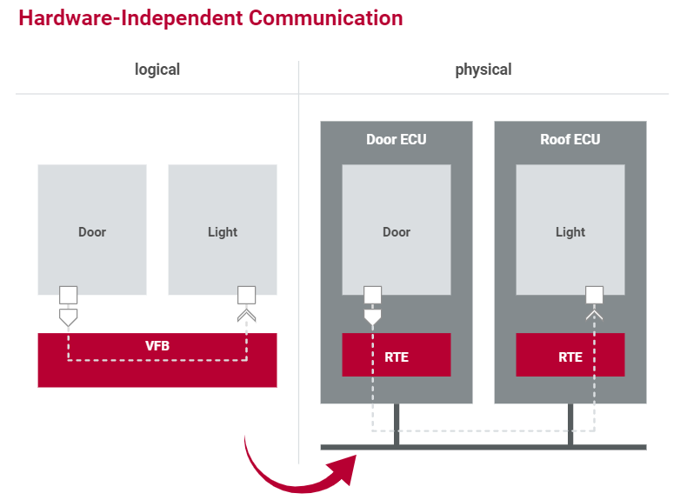
Hardware independent Communication
Virtual Function Bus (VFB):
VFB symbolizes the communication between the components.
The VFB represents the communication within an ECU as well as between ECU’s. The application has no knowledge of the underlying technologies.
The communication between software components is enabled via specific ports using a virtual Function Bus.
These ports also facilitate communication between software components and AUTOSAR Basic Software (BSW)

Slide 13
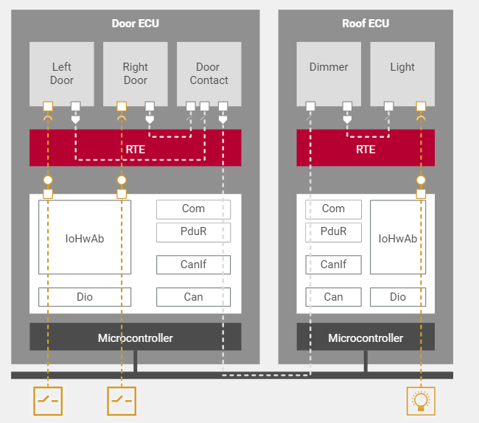
After all SWCs and interfaces have been set up and defined, they are distributed to the relevant ECUs.
Then the ECU-specific Runtime Environment implements the Virtual Functional Bus. The RTE organizes communication between the individual software components and – with the help of the operating system – handles execution of the software components.

Slide 14
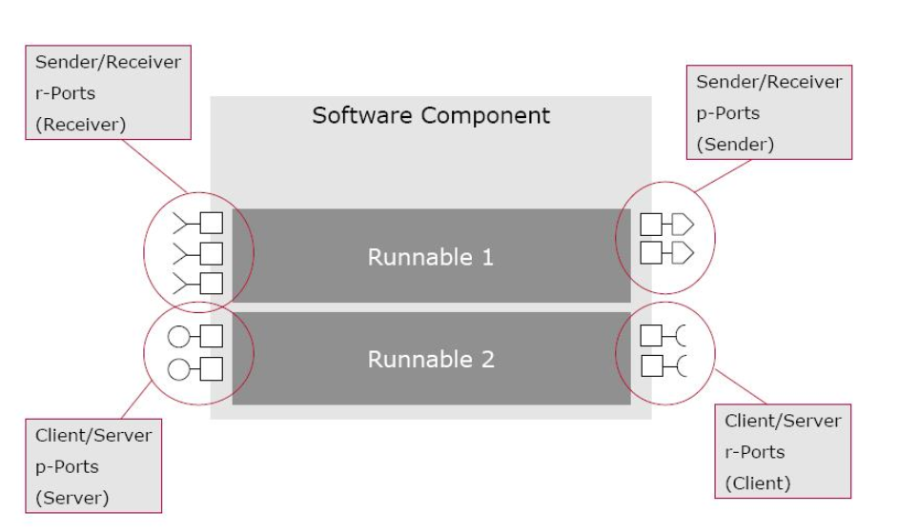
Benefits of SWCs:
Modularity
Portability
Scalability
Interoperability

Slide 15
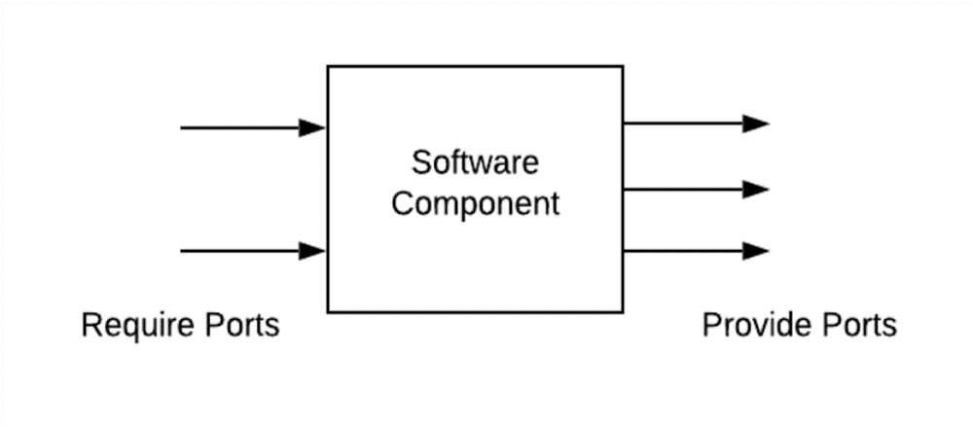
Ports
A port belongs to SWC and it act as the interaction point between a two SWC. A port is associated with a port-interface.
Contents: Data elements (Sender/ Receiver) and Operations (Client / Server).
Provided Ports (P port)
Provided Ports are connection points within a SWC that allow it to expose its services, data, or functionality to other SWCs
Required Ports (R port):
Required Ports are connection points within a SWC that enable it to receive services, data, or functionality from other SWCs

Slide 16
Ports Interfaces
An interface is attached to a port and it describes the data or operations that are provided or required by a SWC via that port. The interface provides a standardized way for components to interact and exchange information.
Types
Sender Receiver Port Interface
Client Server Port Interface

Slide 17
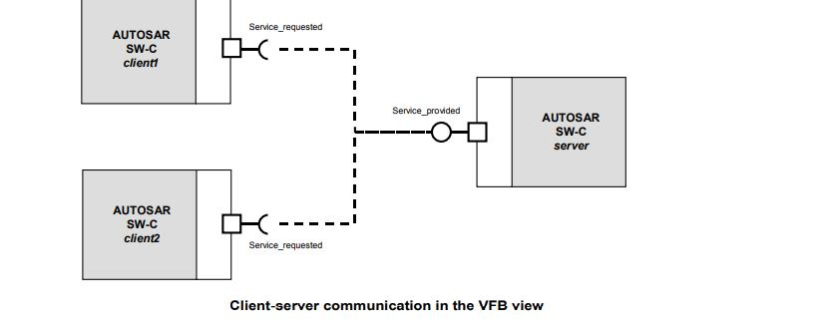
Client Server Port Interface
The server provides services while one or more clients may use its services to carry out tasks.
Contents: Operations
Communication: 1:1 or n:1 (Multiple client to single server)

Slide 18
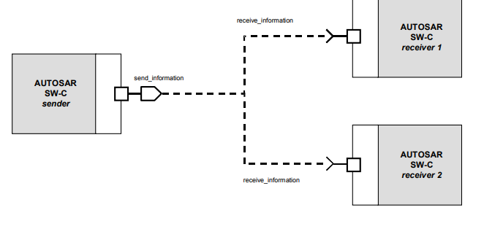
Sender Receiver Port Interface
This way of communicating allows one receiver to get information from multiple senders or a sender to send information to an arbitrary number of receivers.
It defines an asynchronous information distribution and allows for a more data-oriented information exchange over the virtual function bus.
Contents: Data Elements
Communication: 1: n or n:1

Slide 19
Runnable:
Atomic software components contain runnable entities ( Runnable )
It is the function containing the actual implementation and executable unit of a software component
Void Runnable(void)
Software components contains one or more runnable entities (“runnable”)
This function is called by the RTE if the corresponding trigger occurs

Slide 20
RTE (Run Time Environment)
AUTOSAR Run-time Environment is a middleware layer of the AUTOSAR software architecture between the BSW and the application layer and provides communication services for the application software.
The AUTOSAR Software Components communicate with other components (inter and/or intra ECU) and/or services via the RTE.
Task
Make AUTOSAR Software Components independent from the mapping to a specific ECU.
Properties Implementation:
ECU and application specific (generated individually for each ECU)
Upper Interface: completely ECU independent

Slide 21
Functionality:
Middleware providing communication services(Inter/Intra)
The RTE as middleware integrates individual applications with the basic software.
It organizes the communication and data exchange between the two and handles execution of software functions(runnable).
RTE is configured (mapping runnable to OS tasks)
Trigger runnable via RTE events
Configures parts of the OS(tasks, Events, alarms)
Implements communication between components
RTE is different for each ECU and customized to requirement of SWC
RTE prevents SWC from directly accessing OS and BSW
RTE does not have any run time components

Slide 22
The BSW Layer (Basic Software Layer)
BSW can be defined as standardized software module offering various services necessary to run the functional part of upper software layer. This layer consists of ECU specific modules along with generic AUTOSAR modules.
AUTOSAR Basic Software also provides internal ECU services such as state management (ECU state and control of the communication channels), diagnostic services, watchdog services, operating system and management of the nonvolatile memory; even IO is covered within AUTOSAR standardization.
Standardized Basic Software Component:
Services
Communication
Operating System
Microcontroller Abstraction

Slide 23
ECU Specific basic software component:
ECU Abstraction
Complex device drive
BSW Layer subdivided into following Layer:
Service Layer
ECU Abstraction Layer
MCAL Layer (Microcontroller Abstraction Layer)
CDD (Complex Device Driver)

Slide 24
1. Service Layer:
Services Layer offers: Operating system functionality, Vehicle network communication and management services, Memory services (NVRAM management), Diagnostic Services (including UDS communication, error memory and fault treatment), ECU state management, mode management, Logical and temporal program flow monitoring (Wdg manager) .The OS also contained in this layer.
2. ECU Abstraction Layer:
The ECU Abstraction Layer interfaces the drivers of the MCAL. It also contains drivers for external devices. It offers an API for access to peripherals and devices regardless of their location (µC internal/external) and their connection to the µC (port pins, type of interface).

Slide 25
3. MCAL Layer:
The Microcontroller Abstraction Layer is the lowest software layer of the Basic Software. It contains internal drivers, which are software modules with direct access to the µC and internal peripherals
4. CDD:
The Complex Device Drivers contain the drivers for the specific properties of micro controller or ECU which are not standardized in the AUTOSAR.

Slide 26
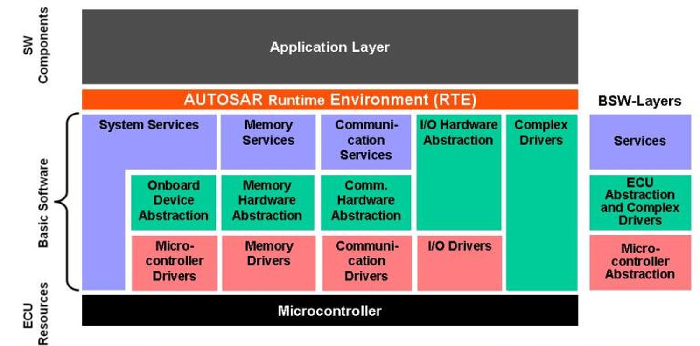

Slide 27
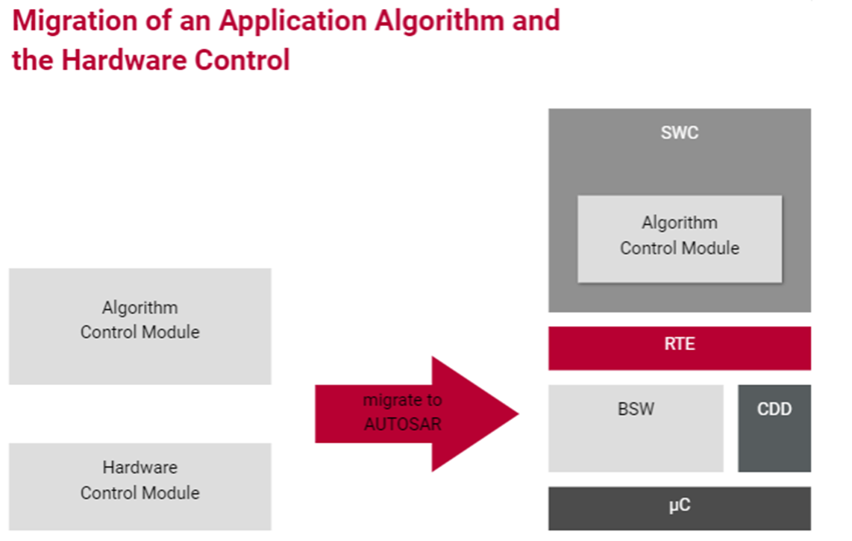

Slide 28
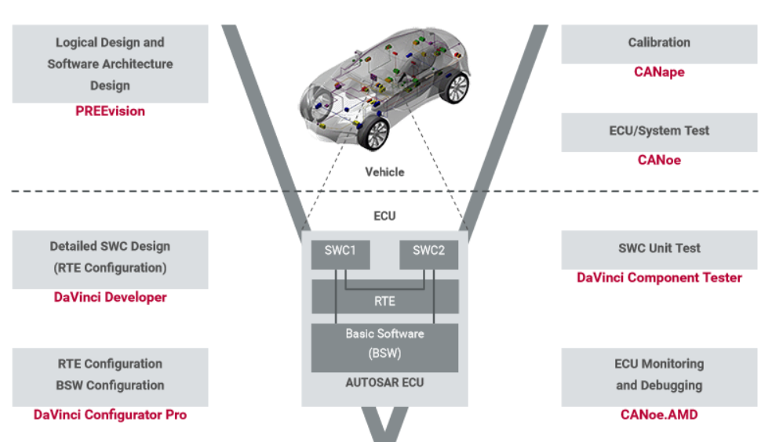

Slide 29
Smarter. Greener. Together.
To learn more about Delta, please visit
www.deltaelectronicsindia.com

